Slide 1

Clustering Myths and Legends
CFUnited August 12-15, 2009
Mike Brunt – CFWhisperer
mbrunt@go2ria.net

Slide 2

Clustering
I have been using CF since 1996, version 1.54 (dbml) and am still actively developing in CF.
I worked for Allaire-Macromedia as a ColdFusion-Spectra consultant.
Co-founded Webapper (SeeFusion crowd) carried on the Allaire-Macromedia consulting work.
This series of slides will detail Clustering we follow to bring relief to clients with ColdFusion/JRun performance problems.

Slide 3
Clustering
From my experiences in the field I see ColdFusion being used in ever larger Enterprises. Typically these organizations either have clustered environments already or are considering moving to a clustered environment.
In this presentation we will cover all that I have encountered relating to clustering ColdFusion over the past 11 years. Including Hardware and Software clustering and the effects that has on application architecture considerations and also address some Myths and Legends!

Slide 4
Clustering
What is Clustering? It is not Load Balancing
Consider Clustering from Day One
Software Clustering (Java – CF – JRun)
Hardware Clustering Considerations
Hardware and Software Clustering
Load Testing Different Algorithms

Slide 5
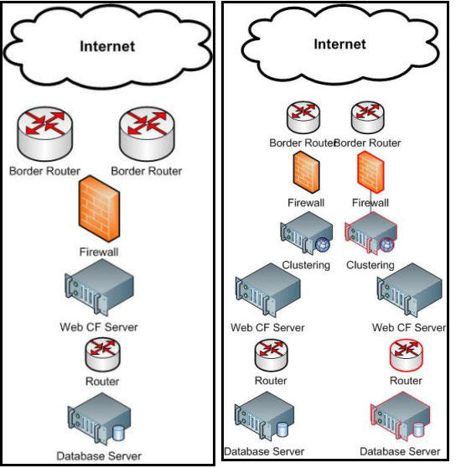
Clustering
The most fundamental point and really the bedrock of HA is when we move from one to two devices. This gives us basic fail-over/redundancy.
No matter how many more devices we add we will never significantly improve redundancy.

Slide 6
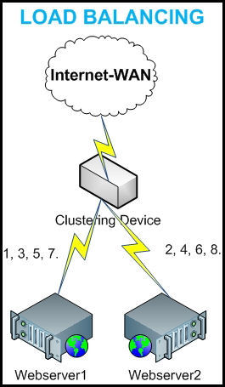
Clustering
What is Clustering - HA?
Often we here the term
“Load-Balancer” when
it should be “Clustering
Device”.
Load Balancing is a part of
Clustering, along with fail-over.
This diagram shows load
balancing using “Round Robin”

Slide 7
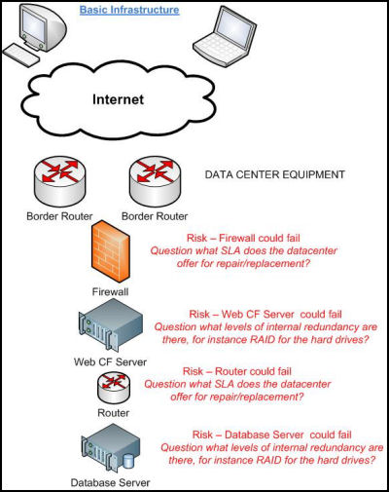
Clustering
No Redundancy
Yes you do need
Clustering!

Slide 8
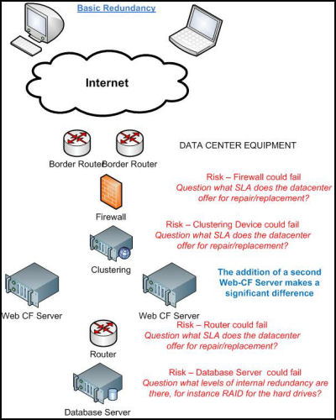
Clustering
Typical Basic Redundancy
Step 1 Web-App Server
This is the most typical
implementation of clustering I see.
It is significantly more
difficult to restore a failed
database server than to restore
a web-CF server.

Slide 9
Clustering
Consider Clustering from Day One.
Here are some important things we need to think about as we bring clustering into the picture.
Synchronizing copies of code.
Session Variables – Client Variables?
Application Variables – Request Scope?
Hard coded localization – directory paths, IP Addresses
Third Party Devices – Databases etc.

Slide 10
Clustering – Step 3
Software Clustering.
Cluster Cats – maximum 8 servers. (Now sadly long gone, despite what some have said ClusterCats was good and Harvest would have been even better.) HARVEST??????
Windows NLB
Ensure ColdFusion Administrator Settings are synchronized. CF 9 will address this at last with the AIR based multi-server manager.
Only Session Scope items can be shared between “Buddies”.

Slide 11
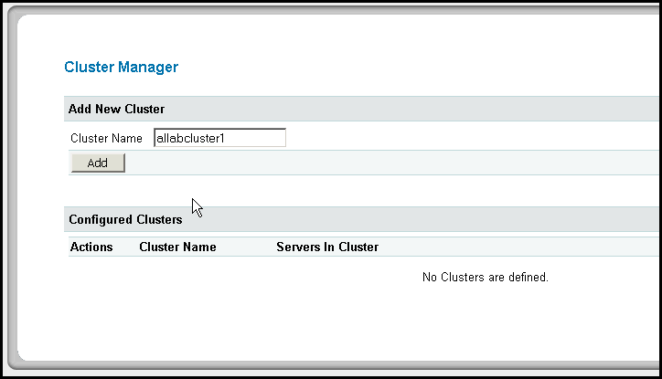
Clustering
Software Clustering – CF8.
1/ Go to Enterprise Manager > Cluster Manager > Cluster Name

Slide 12
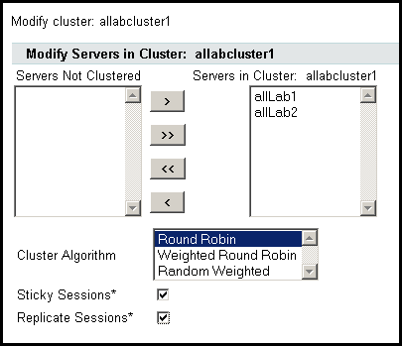
Clustering
Software Clustering – CF8.
2/ Go to Cluster Manager > Select and Add Instances (Servers)
(I have found the most effective algorithm to be RoundRobin with Sticky Sessions)

Slide 13
Clustering
Hardware Clustering Considerations
Hardware Clustering has pretty much the same needs/planning as Software Clustering.
Synchronizing copies of code.
Session Scope Variables – Client Variables?
Application Scope Variables – Request Scope.
Third Party Devices – Databases etc.
Once again I recommend RoundRobin with Sticky Sessions.
One very important point, if the Hardware Clustering device is “pinging” a template on the server/instance make sure it is not also causing lots of code-processes to run. I have seen that bring applications to their knees.

Slide 14
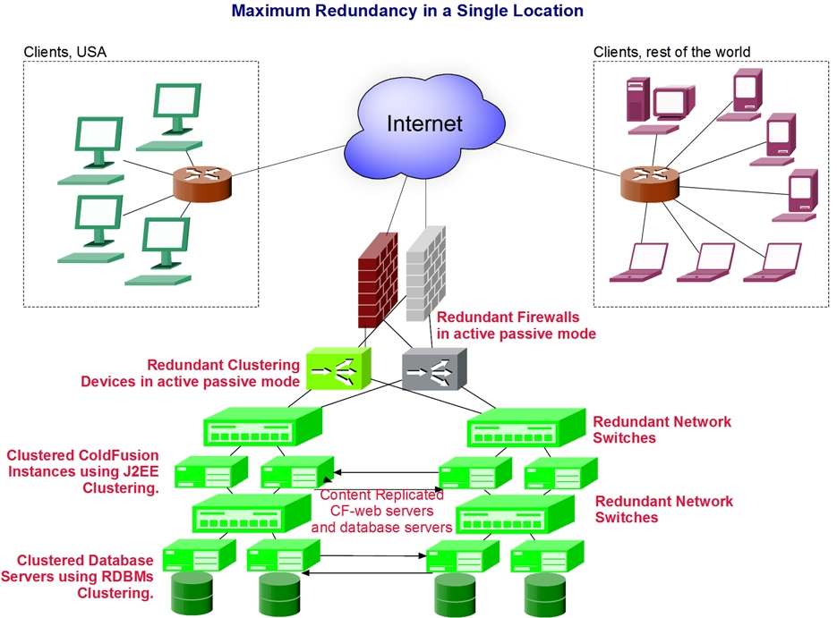
Clustering
Maximum redundancy in a single location.

Slide 15

Clustering
Q & A Time
Mike Brunt – mbrunt@go2ria.net http://www.cfwhisperer.com
(+1)888.511.2821(USA Only)
+1.562.243.6255 (Intl.)

