Slide 1

10 Steps To A Performant Web Application
CFUnited August 12-15, 2009
Mike Brunt – CFWhisperer
mbrunt@go2ria.net

Slide 2

10 Steps
I have been using CF since 1996, version 1.54 (dbml) and am still actively developing in CF.
I worked for Allaire-Macromedia as a ColdFusion-Spectra consultant.
Co-founded Webapper (SeeFusion crowd) carried on the Allaire-Macromedia consulting work.
This series of slides will detail 10 steps we follow to bring relief to clients with ColdFusion/JRun performance problems.

Slide 3
10 Steps
Steps To A Stable and Efficient ColdFusion Application
1/ Analyze Current Production Logs (no more than 7 days old)
2/ Enable Metrics Logging
3/ Enable Verbose Garbage Collection Logging
4/ Analyze Results and Change Arguments – JVM (this is iterative)
5/ Install SeeFusion and along with CF Long Running Request Information, Pin-Point Longest Running Code
6/ Using SeeFusion With JDBC Wrapping, Identify Long Running SQL
7/ Check The RDBM’s For Performance Opportunities (Indexes etc)
8/ Overview The Existing Data Tier Infrastructure.
9/ Load-Test The Changes Both RDBM’s and Code
10/ Deploy The Changes To Production

Slide 4
10 Steps
The next slide shows a server under duress. This was a Windows 2008 Server and we observed that the CPU was constantly hitting 100%, often sitting at 85-90%.
We also observed that the hard-drives were involved in lots of I/O activity…

Slide 5
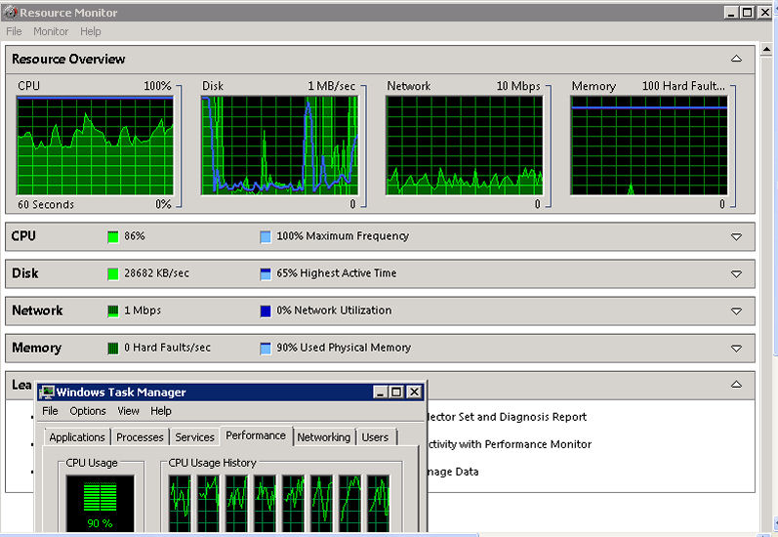
10 Steps

Slide 6
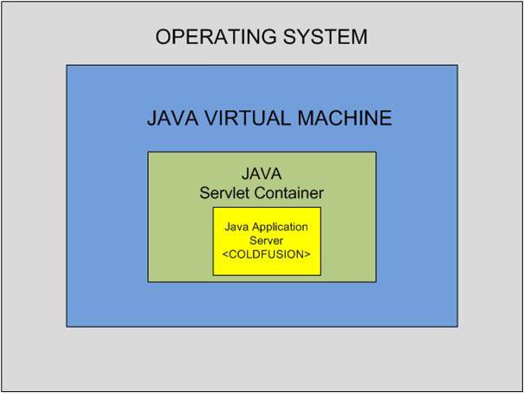
10 Steps
The Heart Of The Matter – The JVM (Java Virtual Machine)
Java was created as a language to “write once run anywhere”. The key to this operating-system agnostic goal is the JVM aka JRE. The graphic here shows the relationship to the operating system and ColdFusion that the JVM occupies. This relationship is the same no matter which installation (Standard or Enterprise) you are using.
One last point, in any Java application there is a JVM, even on phones for instance.

Slide 7
10 Steps – Step 1
Analyze Current Production Logs (no more than 7 days old)
Going back any further than 7 days introduces the possibility of “red herrings” for items that were problems at one time but could recently have been remedied.
Here is an example of the sorts of errors we might be looking for in the {instance}-out.log. OutOfMemory errors are not good, particularly if they relate to the Permanent generation area of the JVM Heap.
05/12 09:09:50 Error [jrpp-2112] - TYPE: java.lang.OutOfMemoryError EXCEPTION: null <br>The error occurred on line -1. PAGE: /internal/slowpage.cfm?printPage=report_internal&requesttimeout=999999 REFERRER: http://acmecorp/internal/slowpage.cfm?PrintPage=report_internal

Slide 8
10 Steps – Step 2
Enable Metrics Logging
Irrespective of whether we have or use ColdFusion Server Monitor, SeeFusion or Fusion Reactor; we always recommend the turning on of Metrics Logging and leaving it on in production. The overhead is insignificant and the help we can get at times of server stress is priceless in some cases. Edit the jrun.xml file…
On a Standard install - {drive}Coldfusion8\runtime\servers\coldfusion\SERVER-INF
On an Enterprise Multiple Instance install - {drive}\JRun4\servers\coldfusion\SERVER-INF

Slide 9
10 Steps – Step 2
Enable Metrics Logging (changes made in yellow). Please note in a Standard install the jrpp prefix needs to be removed.
<!-- -->
<service class="jrunx.metrics.MetricsService" name="MetricsService">
<attribute name="bindToJNDI">true</attribute>
</service>
<!-- ================================================================== -->
<!-- This Service creates the runnable scheduler -->
<!-- ================================================================== -->
<service class="jrunx.scheduler.SchedulerService" name="SchedulerService">
<attribute name="bindToJNDI">true</attribute>
<attribute name="activeHandlerThreads">25</attribute>
<attribute name="maxHandlerThreads">1000</attribute>
<attribute name="minHandlerThreads">20</attribute>
<attribute name="threadWaitTimeout">180</attribute>
<attribute name="timeout">600</attribute>
</service>
<!-- ================================================================== -->
<!-- This Service represents JRun's logging facility -->
<!-- ================================================================== -->
<service class="jrunx.logger.LoggerService" name="LoggerService">
<attribute name="format">{server.date} {log.level} {log.message}{log.exception}</attribute>
<!-- You can modify format to suit your need. -->
<!-- EXAMPLE: <attribute name="format">{date MM/dd HH:mm:ss} {log.message}{log.exception}</attribute> -->
<attribute name="errorEnabled">true</attribute>
<attribute name="warningEnabled">true</attribute>
<attribute name="infoEnabled">true</attribute>
<attribute name="debugEnabled">false</attribute>
<!-- You may also need to uncomment MetricsService if you want metrics enabled -->
<attribute name="metricsEnabled">true</attribute>
<attribute name="metricsLogFrequency">60</attribute>
<attribute name="metricsFormat">Web threads (busy/total): {jrpp.busyTh}/{jrpp.totalTh} Sessions: {sessions} Total Memory={totalMemory} Free={freeMemory}</attribute>
<service class="jrunx.logger.ThreadedLogEventHandler" name="ThreadedLogEventHandler">
<service class="jrunx.logger.ConsoleLogEventHandler" name=":service=ConsoleLogEventHandler" />
<service class="jrunx.logger.FileLogEventHandler" name="FileLogEventHandler">
<attribute name="filename">{jrun.rootdir}/logs/{jrun.server.name}-{log.level}-event.log</attribute>

Slide 10
10 Steps – Step 2
Enable Metrics Logging example output goes into the –out.log and also into a dedicated metrics log which is created as a result of the previous changes in the jrun.xml from use of the {log.level} modifier, in the jrun.xml file.
01/05 12:17:09 metrics Web threads (busy/total/wait): 1/28/0 Sessions: 1 Total Memory=520048 Free=158060
01/05 12:18:09 metrics Web threads (busy/total/wait): 1/28/0 Sessions: 1 Total Memory=520432 Free=215408
01/05 12:19:09 metrics Web threads (busy/total/wait): 1/28/0 Sessions: 1 Total Memory=520984 Free=164688
01/05 12:20:09 metrics Web threads (busy/total/wait): 1/27/0 Sessions: 1 Total Memory=520000 Free=93655
01/05 12:21:09 metrics Web threads (busy/total/wait): 1/27/0 Sessions: 1 Total Memory=520832 Free=58571
01/05 12:22:09 metrics Web threads (busy/total/wait): 1/27/0 Sessions: 1 Total Memory=520792 Free=83309
01/05 12:23:09 metrics Web threads (busy/total/wait): 1/27/0 Sessions: 1 Total Memory=520496 Free=105955
In this example we are looking at three thread states
1/ busy – threads actually in use
2/ total – the total number of all threads in use in the JVM Heap
3/ wait or delayed – this is threads that are ready to be used but cannot be used because all available threads are in use,

Slide 11
10 Steps – Step 3
3/ Enable Verbose Garbage Collection Logging
In step 3 we will enable verbose garbage collection logging, these details apply to the Sun Java Virtual Machine (JVM). We will already have some indication of how the total and free memory is behaving from the data produced by the metrics logging we enabled in step 2.
01/05 12:17:09 metrics Web threads (busy/total/wait): 1/28/0 Sessions: 1 Total Memory=520048 Free=158060
01/05 12:18:09 metrics Web threads (busy/total/wait): 1/28/0 Sessions: 1 Total Memory=520432 Free=215408
01/05 12:19:09 metrics Web threads (busy/total/wait): 1/28/0 Sessions: 1 Total Memory=520984 Free=164688
01/05 12:20:09 metrics Web threads (busy/total/wait): 1/27/0 Sessions: 1 Total Memory=520000 Free=93655
01/05 12:21:09 metrics Web threads (busy/total/wait): 1/27/0 Sessions: 1 Total Memory=520832 Free=58571
01/05 12:22:09 metrics Web threads (busy/total/wait): 1/27/0 Sessions: 1 Total Memory=520792 Free=83309
01/05 12:23:09 metrics Web threads (busy/total/wait): 1/27/0 Sessions: 1 Total Memory=520496 Free=105955
The Memory= metric shows the total memory available to the Java Virtual Machine (JVM) heap and the Free= metric shows how much memory is still available to the heap, unused. In this case, we can already see that free memory gets very low from time to time, what we want to look at next, is the detail of what the generations of memory in the JVM heap are doing.

Slide 12
10 Steps – Step 3
Enable Verbose Garbage Collection Logging (The Three Main JVM Heap Generations)
The New or Young Generation - This is where all objects created in an application first go, to be very basic when someone clicks on something an object is created in memory and goes into the New-Young generation. At this point there will be "references" to that object from the application and ongoing garbage collections check all objects for references. After around 40 to 45 attempts to collect an object, in the New-Young generation it is moved to the next generation, if it cannot be collected, that generation is called the Old or Tenured generation.. One point about the New-Young generation is that in almost every case we observe this generation at 100% in ColdFusion applications. In many of those cases we cannot set that generation high enough to avoid 100% usage, this comment applies to 32-bit installs.
The Old or Tenured Generation - As mentioned in the section above, objects that are not collected whilst in the New-Young generation, after 40-45 attempts, are moved into the Old-Tenured generation. This generation is effectively only collected when there is a Full Garbage Collection (Full GC). Full GC's, in the current family of Sun JVM's are "stop-the-world" events in the sense that for the duration of the Full GC the JVM stops doing all else. Therefore, too many Full GC's of too long a duration will impact performance, negatively and that is one of the things we always look for.
The Permanent Generation/PermGen - This is where the classes required by JRun-ColdFusion are stored along with some of the cached objects in the ColdFusion application layer. The thing that we want to avoid here is this generation permanently sitting at 100% with no room to grow. In a lot of cases, we have seen out of memory errors caused by the permanent generation running at 100%.

Slide 13
10 Steps – Step 3
Enable Verbose Garbage Collection Logging
The way that we enable verbose garbage collection, is by passing 4 arguments to the JVM via the jvm.config file. This is an example of those arguments...
-XX:+PrintGCDetails -XX:+PrintGCTimeStamps -XX:+PrintHeapAtGC -verbose:gc -Xloggc:cfwhispererGC.log
This set of arguments will produce logging output which will go into a file called "cfwhispererGC.log" in the {drive}\JRun4\bin directory on an Enterprise multiple instance install and into the {drive}\ColdFusion8\runtime\bin directory on a standard install of ColdFusion. The next slide has sample output…

Slide 14
10 Steps – Step 3
Enable Verbose Garbage Collection Logging – here is actual sample output.
{Heap before GC invocations=1281 (full 2):
PSYoungGen total 55360K, used 55360K [0x2bef0000, 0x2f7d0000, 0x2f7d0000)
eden space 52608K, 100% used [0x2bef0000,0x2bef0000,0x2f250000)
from space 2752K, 67% used [0x2f250000,0x2f422630,0x2f500000)
to space 2816K, 0% used [0x2f510000,0x2f510000,0x2f7d0000)
PSOldGen total 466048K, used 464447K [0x0f7d0000, 0x2bef0000, 0x2bef0000)
object space 466048K, 99% used [0x0f7d0000,0x2bd5fde8,0x2bef0000)
PSPermGen total 46848K, used 46842K [0x037d0000, 0x06590000, 0x0f7d0000)
object space 46848K, 99% used [0x037d0000,0x0658e878,0x06590000)
This tells us that there have been a total of 1281 garbage collections of which 2 were Full GC's.{Heap before GC invocations=1281 (full 2):
It also shows us that the New-Young generation is at 100% used - PSYoungGen total 55360K, used 55360K [0x2bef0000, 0x2f7d0000, 0x2f7d0000)
In addition, that the Permanent generation is at 99% used - PSPermGen total 46848K, used 46842K [0x037d0000, 0x06590000, 0x0f7d0000) object space 46848K, 99% used [0x037d0000,0x0658e878,0x06590000)

Slide 15
10 Steps – Step 3
Enable Verbose Garbage Collection Logging
The arguments we need to pass to tune the JVM memory behavior will be added to the jvm.config file which resides here…
On a Standard install - {drive}Coldfusion8\runtime\bin\
On an Enterprise Multiple Instance install - {drive}\JRun4\bin\
In a default install of ColdFusion the initial memory settings are these…
java.args=-server -Xmx512m XX:MaxPermSize=192m
These are inadequate in almost every case all we have here are upper limits on the total and permanent generation. Let’s revisit the metrics logging output…

Slide 16
10 Steps – Step 4
Analyze Results and Change Arguments – JVM (this is iterative)
Verbose GC Output:
PSYoungGen total 55360K, used 55360K [0x2bef0000, 0x2f7d0000, 0x2f7d0000)
eden space 52608K, 100% used [0x2bef0000,0x2bef0000,0x2f250000)
from space 2752K, 67% used [0x2f250000,0x2f422630,0x2f500000)
to space 2816K, 0% used [0x2f510000,0x2f510000,0x2f7d0000
We will use this output to add/modify the arguments to the JVM via the jvm.config file…
Defaults at CF install - java.args=-server -Xmx512m XX:MaxPermSize=192m
Modified - java.args=-server Xms1024m –Xmx1024m -XX:PermSize=96m -XX:MaxPermSize=192m -XX:NewRatio=3
This will start the heap with 1GB of space with the same max ceiling value, give the Permanent Generation a start size of 96MB and allocate one quarter of the total heap size (256MB) to the New/Young Generation.

Slide 17
10 Steps – Step 5
Install SeeFusion
The next step in the eventual achievement of stability and improved performance is to install a server-database monitoring utility. We currently have 3 choices in this respect, as follows; with comments:
ColdFusion Server Monitor - The Server Monitor which comes with ColdFusion has some interesting features; my favorite area being the "statistics" area. However, the focus of this series relates to troubleshooting and applying remedies to servers with performance problems, in production and in my experience, the ColdFusion Server Monitor is not what I choose to use; as a light footprint is the most critical need, in my experience.
FusionReactor - FusionReactor is one of two commercial products available for monitoring ColdFusion and if needed, JRun. FusionReactor is a very fully featured and polished with an amazing GUI interface. I have encountered it many times and used it a good number of times and it is definitely worth considering, in my opinion.
SeeFusion - SeeFusion is the tool that we use on all our assignments. SeeFusion was developed and released by Webapper at a time when I was co-owner of Webapper, I state to be fair and to disclose my ties to it. Although I was not involved in the software development of SeeFusion I was very involved in shaping its functionality. Having spent the past ten years at the server-network side of things I know what I need to quickly diagnose the root causes of ColdFusion hanging and similar/related issues. SeeFusion is incredibly lightweight in terms of any performance footprint. Almost every client I ever used SeeFusion with still have it running, in production. In this step, step 5 in this series, I will concentrate on the installation and use of SeeFusion.

Slide 18
10 Steps – Step 5
Install SeeFusion
SeeFusion has two methods of install, for Microsoft Windows installations. An MSI file that will do everything needed to get SeeFusion up and running and a manual install method which involves the download of a JAR and a PROPERTIES file and the adding of 8 lines to the {drive-volume}:\JRun4\servers\{instance}\cfusion.ear\cfusion.war\WEB-INF\web.xml (in a Enterprise install) or {drive-volume}:\ColdFusion8\runtime\servers\{instance}\cfusion.ear\cfusion.war\WEB-INF\web.xml (in a Standard install)
If there are multiple ColdFusion instances, the manual install is better, in my experience. In the next section, we will go through the steps needed to get SeeFusion up and running.

Slide 19
10 Steps – Step 5
Install SeeFusion
Place the following XML before the first <servlet> block in your server's WEB-INF\web.xml file:
<filter>
<filter-name>SeeFusion</filter-name>
<filter-class>com.seefusion.SeeFusion</filter-class>
</filter>
<filter-mapping>
<filter-name>SeeFusion</filter-name>
<url-pattern>/*</url-pattern>
</filter-mapping>

Slide 20
10 Steps – Step 5
Install SeeFusion
Download the seefusion.jar and seefusion.properties files from http://www.seefusion.com. Copy the seefusion.jar file to one of these two directories (this is a Windows example).
In a Multiple Instance install: {drive-volume}:\JRun4\servers\{instance}\cfusion.ear\cfusion.war\WEB-INF\lib directory
In a Standard install: {drive-volume}:\ColdFusion8\runtime\servers\{instance}\cfusion.ear\cfusion.war\WEB-INF\lib directory
Copy the seefusion.properties file to one of these two directories (this is a Windows example).
In a Multiple Instance install: {drive-volume}:\JRun4\servers\{instance}\cfusion.ear\cfusion.war\WEB-INF\classes directory. Where we have multiple ColdFusion-JRun instances we need to have each running on its
own dedicated port. In order to do this, open the seefusion.properties file for the second successive instances and edit the first line, change from listeners=all:8999 to listeners=all:9000 and so on for other instances.
In a Standard install: {drive-volume}:\ColdFusion8\runtime\servers\{instance}\cfusion.ear\cfusion.war\WEB-INF\classes directory

Slide 21
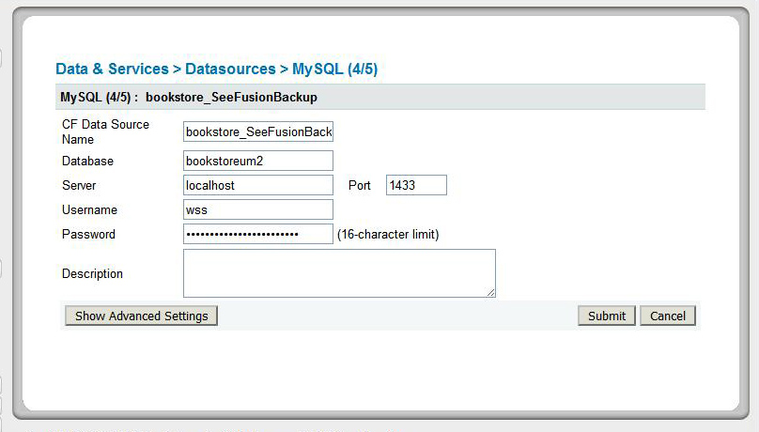
10 Steps – Step 6
Install SeeFusion “Wrap” the key datasources.

Slide 22
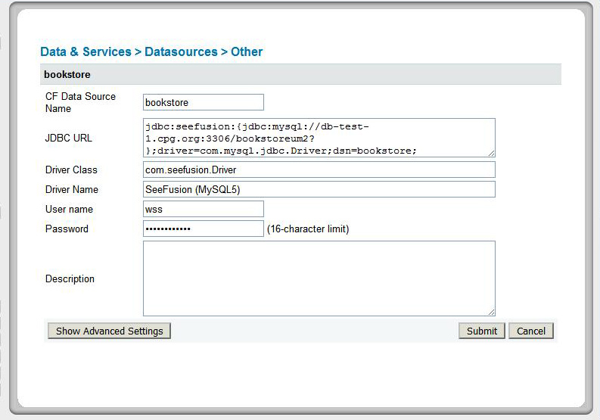
10 Steps – Step 6
Install SeeFusion “Wrap” the key datasources.

Slide 23
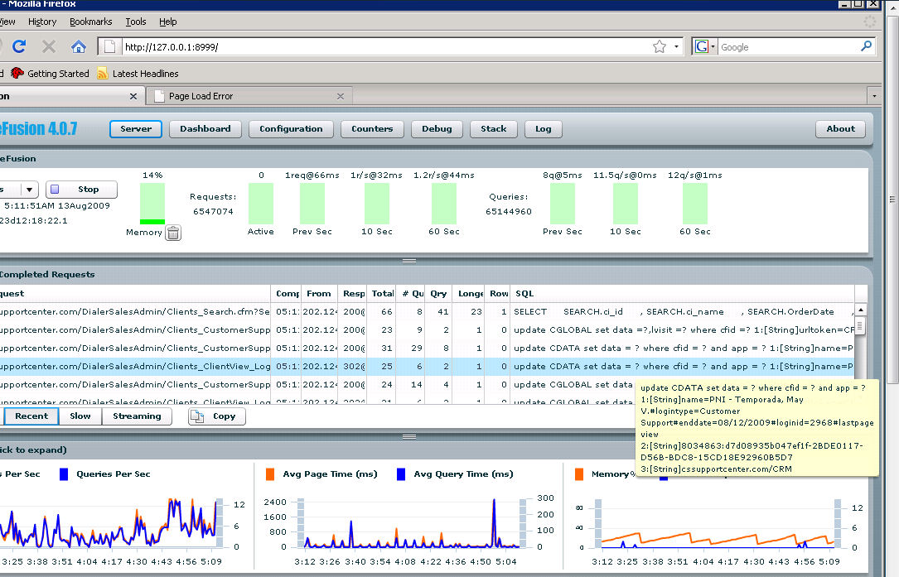
10 Steps – Step 7
9/ Analyze SeeFusion Output

Slide 24
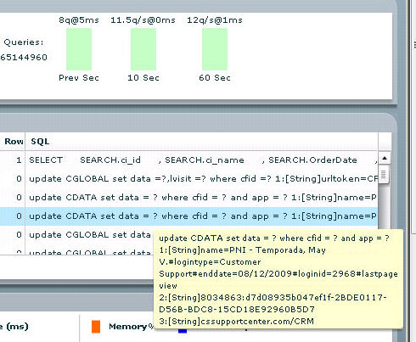
10 Steps – Step 8
Analyze SeeFusion Output – Database/SQL

Slide 25
10 Steps – Step 9
Establish a baseline for non-performing SQL.
(In database terms a query lasting for long than one second is a slow query).
Look for “deadlock” errors in the logs/SeeFusion.
Review Indexes on all DB tables.
Analyze SeeFusion Output – Database/SQL

Slide 26
10 Steps – Step 10
Create an action plan to target the slowest running requests both in terms of code and/or database.
Prioritize the action plan in terms of worst offenders first.
Work through the action plan re-iterating through previous actions as and when necessary.
Bring all information together – action

Slide 27

Clustering
Q & A Time
Mike Brunt – mbrunt@go2ria.net http://www.cfwhisperer.com
(+1)888.511.2821(USA Only)
+1.562.243.6255 (Intl.)

