Slide 1
Geolocation with ColdFusion
Oğuz Demirkapı
CTO | NicheClick Media

Slide 2
About Me
CTO at NicheClick Media
Coding since ‘85, CGI Programming since ’94
ColdFusion Developer since ’97 (Flex since ‘07)
Adobe Certified Expert
Founder of ColdFusion Users Group Turkey (‘99)
Founder and Manager of Orange County Adobe Developers User Group (OCDev.org)
Interested in ColdFusion, Flex, AIR, Ajax, Frameworks, i18N, L10N, G11N
Have big interest in Epistemology
Working in Aliso Viejo, CA and living in Dana Point, CA
Personal blog: http://blog.demirkapi.net

Slide 3
What You May Expect
Open Your Eyes, if;
May be not for you, if;
You are a newbie in Geolocation
You heard that you should use the power of Geolocation in your applications
You need to get an idea how to get into Geolocation with ColdFusion
You want to get some tips on Geolocation
You already created Geolocation based projects.
You think I know everything about Geolocation ☺

Slide 4
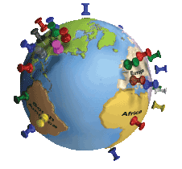
What is Geolocation?
Geolocation is the identification of the real-world geographic location of an Internet-connected computer, mobile device, website visitor or other.
Geolocation may refer to the practice of assessing the location, or to the actual assessed location, or to locational data.
  Wikipedia

Slide 5
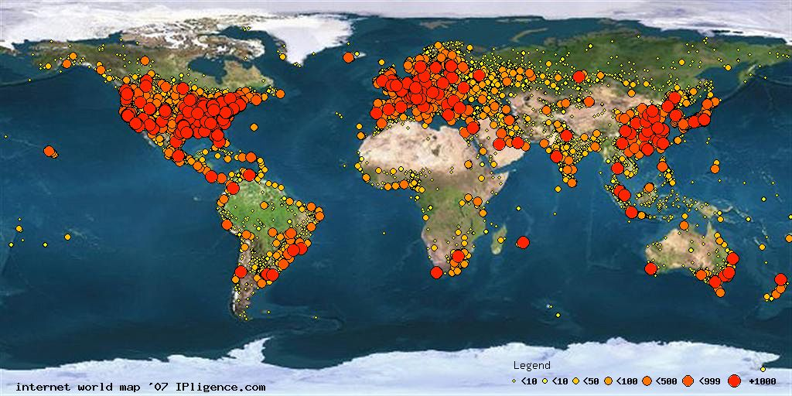
Internet Map
http://www.ipligence.com/worldmap/internet-map.jpg

Slide 6
Why We May Need Geolocation?
Improve collaboration & decision-making
Increase public understanding of conservation & social issues
Increase number of website hits, volunteers, and donations
Provide tools for your visitors
  Store Locator
  Ordering
  Direction
  Social platform tools

Slide 7
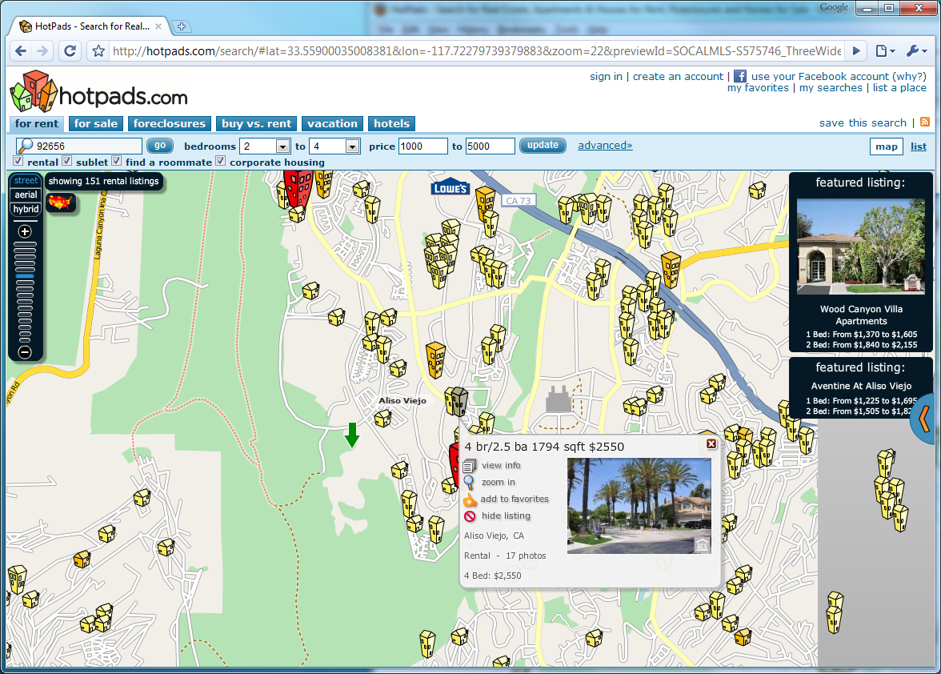
Some Samples – hotpads.com

Slide 8
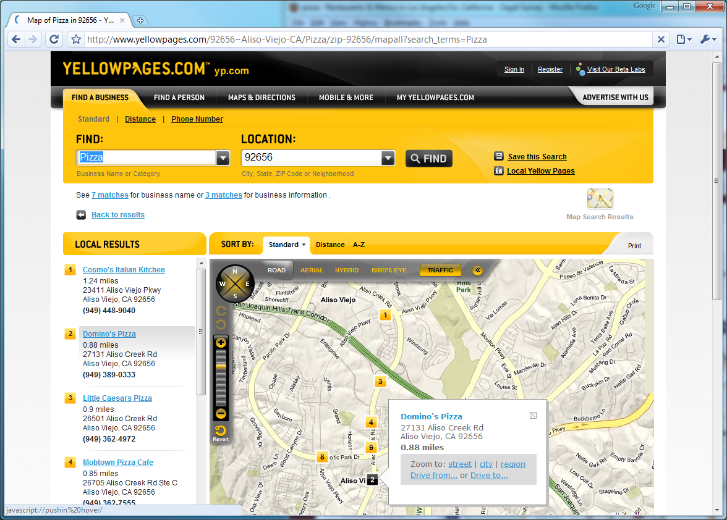
Some Samples – yellowpages.com

Slide 9
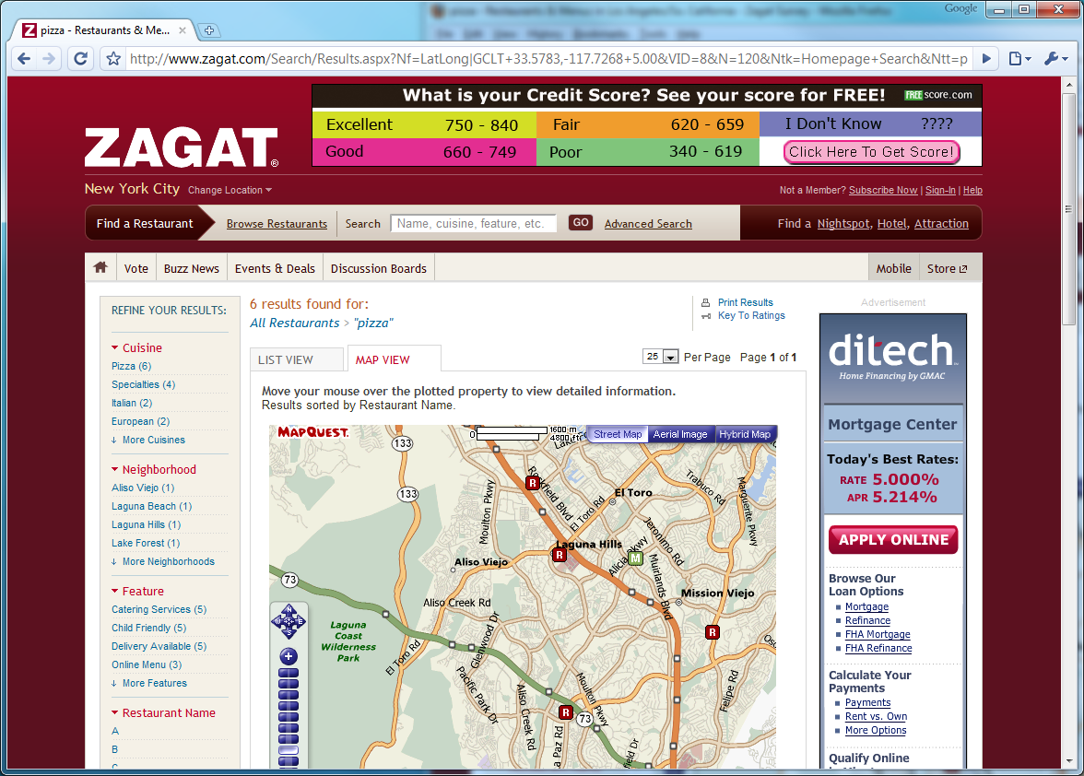
Some Samples – zagat.com

Slide 10
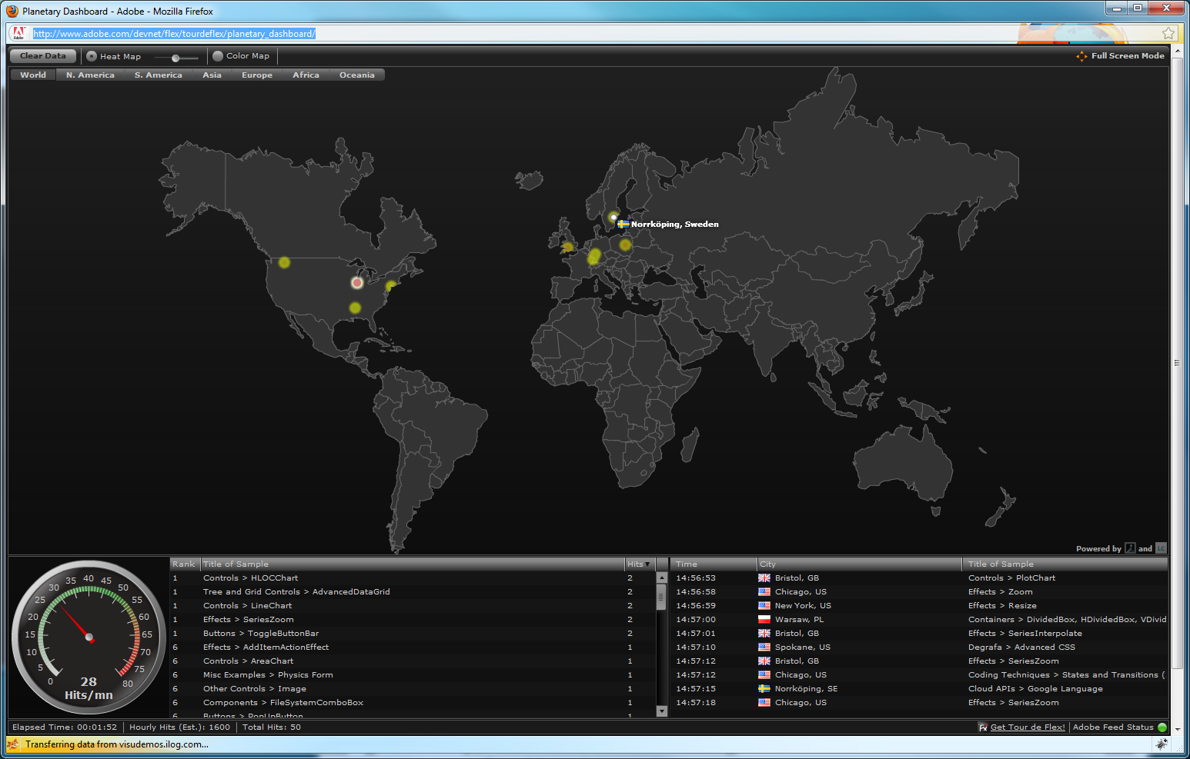
Tour De Flex Planetary Dashboard
http://www.adobe.com/devnet/flex/tourdeflex/planetary_dashboard/

Slide 11
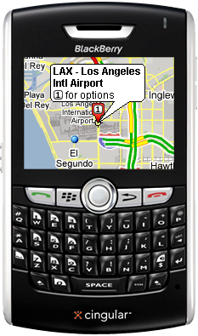
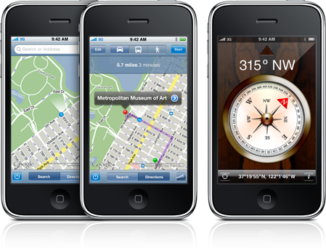
Some Samples – Mobile Devices

Slide 12
Some Terminology
Location
    Latitude, longitude and altitude
Place
    Location + meaning
    Speed
  Some others
    GeoMarketing, Geo Targeting, GeoCoding, GeoTagging

Slide 13
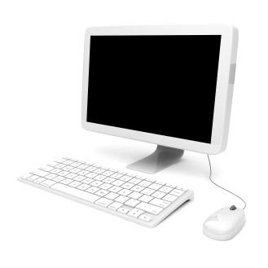
What We Have
An Internet-connected computer
Mobile device
Website visitor

Slide 14
How We Detect?
GPS (Global Positioning System)
IP Address
MAC Address
  Devices
RFID (Radio-frequency identification)
WiFi Connection
Or custom solutions

Slide 15
GPS (Global Positioning System)
Uses signals from 24 satellites (about 10 at a time)
  Calculates position by knowing the position of the satellites and the delay in time from each satellite
Accuracy for commercial version ~50ft (15 m)

Slide 16
Mobile Devices (Towers)
Mobile decide connection points such as cell phone tower data can be used to find a device’s location
  A phone connects to a single tower at a time – the one w/ the strongest signal (closest)
  Each tower has a unique ID made up of a MCC, MNC, LAC and CID
    The MCC & MNC are specific to a country
    The LAC & CID are unique to each tower
  There are a lot of towers!

Slide 17
Mobile Devices (Applications)
iPhone, BlackBerry and other smart phones has already embedded applications
Requires a data connection to the internet
Loopt, Google Latitude, BrightKite

Slide 18

Internet Protocol (IP)
All devices on the Internet have an IP
Wired Networks
  DSL/Cable/FiOS etc.
  Enterprise Networks: Wire maps
Wireless Networks
  Base station locations
  Network measurements
    Signal strengths from clients
    Time to arrival of signals

Slide 19
Internet Protocol (IP) & ISPs
ISP’s are in a key position
  All IPs are registered and it is possible to detect the IP owner
    RIPE, ARIN, APNIC etc.
  ISPs can assign location information for IP blocks

Slide 20
Detecting/Converting Data
IP to Location (Country, Region, City, ZIP)
IP to ISP, Domain Name, Net Speed
IP to Lat/Long
IP to Timezone
IP to Area / IDD Code
IP to Weather
Address to Location
Address to Lat/Long, Timezone
ZIP to Lat/Long, Timezone

Slide 21
Detecting/Converting Data – Services
Geonames (http://geonames.org)
IPInfoDB (http://ipinfodb.com)
IP2Location (http://ip2location.com)
MaxMind (http://maxmind.com)
HostIP.info (http://hostip.info)
Ipligence (http://ipligence.com)
and tons of others …

Slide 22
Detecting/Converting Data – Databases
Geonames
    http://download.geonames.org
IPInfoDB
    http://www.ipinfodb.com/ip_database.php
MaxMind
    http://geolite.maxmind.com/download/
HostIP.info
    http://www.hostip.info/dl/
Tons of other commercial DBs

Slide 23
Available ColdFusion Tools
InetAddressLocator
    http://javainetlocator.sourceforge.net
GeoMind (Uses MaxMind)
    http://geomind.riaforge.org
Google GeoCode
    http://googlegeocode.riaforge.org
SimpleGeocode
    http://simplegeocode.riaforge.org

Slide 24
Rendering Data
Maps
  Google Maps
  Yahoo Maps
  Mapquest
  Bing Maps

Slide 25
ColdFusion Tools for Mapping
CF_GoogleMap
  http://cfgooglemap.riaforge.org
cf_gMap
  http://www.coldfusionguy.com/googlemaps/cf_gmap.htm

Slide 26
ColdFusion 9 CFmap
ColdFusion 9 has embedded tag as CFmap
  Embeds a Google Map
  Google API keys must be defined
    CFAjaximport
      <cfajaximport params="#{googlemapkey='Map API Key'}#" >
    Application.cfc
      <cfset this.googlemapkey="Map API Key">
    ColdFusion Administrator
  Contains different mapping parameters
    Lat/Long
    Address
    Zip
  Contains different rendering
    Map, Hybrid, Satellite

Slide 27
ColdFusion 9 CFmap
<cfmap name="MyHome"
  centerlatitude="33.488708" centerlongitude="-117.700009"
  doubleclickzoom="true" overview="true" scrollwheelzoom="true" showscale="true”
  tip="My Home" zoomlevel="4” />
<cfmap name="MyOffice"
centeraddress=”27373 Aliso Creek Rd., Aliso Viejo, CA 92656, USA" doubleclickzoom="true" scrollwheelzoom="true" showscale="false"
tip=”NicheClick Media” />

Slide 28
Railo CFmap
Created TODAY (15 Aug ‘09)! ☺
Same like ColdFusion CfMap or any name that you like!
    You can rename the tag on your tags directory.

Slide 29
Flex/Flash Tools for Mapping
Tour de Flex Map Samples
    http://www.adobe.com/devnet/flex/tourdeflex/
Google Maps API for Flash
    http://code.google.com/apis/maps/documentation/flash/
Yahoo! Maps Flash APIs
    http://developer.yahoo.com/maps/flash/
Bing Maps
    http://www.microsoft.com/maps/developers/

Slide 30
Demo & Code

Slide 31
References
Geolocation
    http://en.wikipedia.org/wiki/Geolocation
RiaForge
    http://riaforge.com
My Blog
    http://blog.demirkapi.net

Slide 32
Questions & Answers
?
Oğuz Demirkapı
http://blog.demirkapi.net
presentations@demirkapi.net

