Slide 1
Building Scalable
Web Applications with ColdFusion
Oğuz Demirkapı
CTO | NicheClick Media

Slide 2
About Me
CTO at NicheClick Media
Coding since ‘85, CGI Programming since ’94
ColdFusion Developer since ’97 (Flex since ‘07)
Adobe Certified Expert
Founder of ColdFusion Users Group Turkey (‘99)
Founder and Manager of Orange County Adobe Developers User Group (OCDev.org)
Interested in ColdFusion, Flex, AIR, Ajax, Frameworks, i18N, L10N, G11N
Have big interest in Epistemology
Working in Aliso Viejo, CA and living in Dana Point, CA
Personal blog: http://blog.demirkapi.net

Slide 3
What You May Expect
Open Your Eyes, if;
You are a newbie in application development
You feel that you are going to have more users on your applications.
You need to get an idea how to get into scalable applications.
You want to get some tips on best practices.

Slide 4
Theory

Slide 5

What is Scalability?
Scalability is a web server's ability to maintain a site's availability, reliability, and performance as the amount of simultaneous web traffic, or load, hitting the web server increases.

Slide 6

Availability
Server down?
Network problems?
Distributed services around the world?

Slide 7

Reliability
Consistency of availability
Restarting the server to recover?
Average up/down time?
Errors?

Slide 8

Reasons of Performance Issues
Because of hardware/network resources
Because of the code
Because of database
Slow assets
    External references to libraries
Load issues
    Max. users

Slide 9
Where/How to Scale?
Scale Vertically (Scale Up)
  Adding more resources (CPU, RAM)
  Easy with Virtualization
  Cloud (Better!!!)
Scale Horizontally (Scale Out)
  Adding more nodes
    Clustering
    Load Balancing
    Partitioning

Slide 10
Partitioning
Vertical Partitioning
  Every nodes has a specific role
    Web/Application/Database/Search Servers
Horizontal Partitioning
  Every nodes has same role
  Distributed resources
    USA/Europe/Asia

Slide 11
Proxies / Mirrors
Content Delivery Networks
    Akamai etc.
    Detect dynamically closest servers
Enterprise Businesses
    Own content delivery

Slide 12
Layers
Internet (Backbones)
Network (ISPs)
Servers
  Operating System (Windows, Linux, Unix)
  Web Server (IIS, Apache)
  Application Server (ColdFusion, PHP, .Net)
  Databases (MySQL, MSSQL)

Slide 13
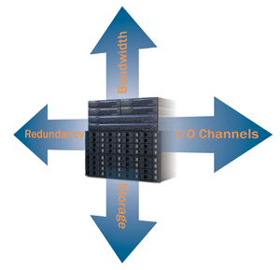
Hardware

Slide 14
Network
Backbones
Service Providers (ISPs)
  Bandwidth
  Allowed data usage/traffic
Cloud computing
  Pros / Cons
Domain Services
Power redundancy

Slide 15
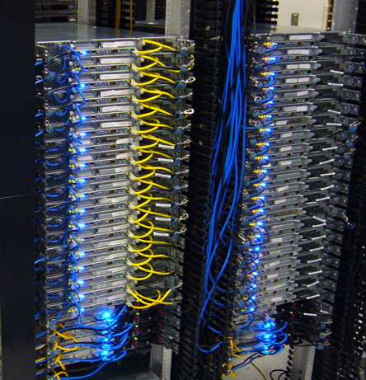
Servers
Resources
    RAM/HDD/Network speed
Available backup server hardware
RAID and better HDDs

Slide 16

Clustering
A computer cluster is a group of linked computers, working together closely so that in many respects they form a single computer.
Hardware Clusters
Software Clusters

Slide 17
Project
Management

Slide 18
Organizing Development/Deployment
Personal environments
Staging
  Testing application & acceptance
Sub-Staging
  Testing with only production data
Production
  Beta production

Slide 19
Tracking
Source Control
Milestones, Builds, Patches
Problems/Bugs
  Ticketing System
Customer Requests
  Collecting feedbacks
  Better collaboration

Slide 20
Automation & Testing
Testing
  Continuous Integration (CI) testing
    Hudson
Deploying
  Ant
  Version Control

Slide 21

Software

Slide 22

Operating System (OS)
Selecting right OS for the task
  Speed/Overload
  Clustering possibilities
  Easy of recovery
Using 64 bit power
Using shared network storage

Slide 23
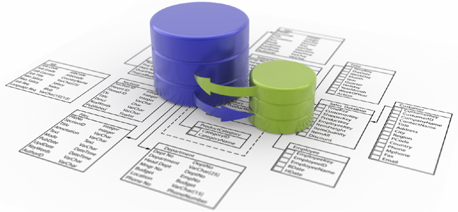
Database
Database High availability
  Clustering
    Active/passive
    Read only nodes
Data Replication
Partitioning
Backup/Restore
Better Database Design
Being aware possible problems (indexing, locking etc.)

Slide 24
Architecting Application
Coding Standards
Using best practices
  CFCs, OOP etc.
Frameworks
  MVC
  Provide standards

Slide 25
Application Testing
Having the right infrastructure for testing
Unit Testing
Integration Testing
Acceptance/UI tests
Regression Testing
Continuous Integration (CI) Testing
Load Testing

Slide 26
Internationalization (i18N) & Localization (L10N)
Handling multi languages/locales
Designing the application in first place
Unicode support

Slide 27
Skinning
Isolating the application core from UI
  Themes
Using modern design techniques
  XHTML/CSS

Slide 28
Security
Only required ports on any server
Communicate via only required ports in nodes
Testing applications for possible attacks

Slide 29



ColdFusion

Slide 30
ColdFusion Settings & Installation
Beware on settings and tune the server
    Compare servers with ColdFusion 9 server manager
If possible use multi server installation
Update JVMs and other libraries

Slide 31
Scopes
Using right scope for right place
      Server, Application, Session, Client, Request
      Mission critical in large applications
Deciding the right approach
  Clustering
    Client variables
    Session variables (Sticky sessions)
    Cluster scope (Railo)

Slide 32
Partitioning with ColdFusion
Create nodes for specific tasks
      Admin server
      Photo management server
      Video editing server
      Reporting server
Using subdomains for resources
  Assets delivery
    Photos, videos, static content

Slide 33
Caching & Scopes
Caching the common parameters
  Server, application wide parameters
  Right scope for common stuff
    Queries, searches etc.
Caching/generating common content
  Generating static pages
  Using advanced caching (Cluster cache etc.)
  Using content delivery networks

Slide 34
Debugging Profiling/Monitoring ColdFusion
Debugging Tools
  ColdFusion Builder
  ColdFusion Extensions (8)
  Fusion Debug
Monitoring Tools
  Server Monitoring in ColdFusion 8/9
  FusionReactor http://www.fusion-reactor.com
  SeeFusion http://www.seefusion.com

Slide 35
References
Adobe DevNet
    http://www.adobe.com/devnet/coldfusion/
RiaForge
    http://riaforge.com
My Blog
    http://blog.demirkapi.net

Slide 36
Questions & Answers
?
Oğuz Demirkapı
http://blog.demirkapi.net
presentations@demirkapi.net

